Slide 1

22AIE112 : DATA STRUCTURES & ALGORITHMS 1
22AIE111 : OBJECT ORIENTED PROGRAMMING IN JAVA
Fitness Member Management System
Team 8 AIE - C
G Prajwal Priyadarshan – CB.SC.U4AIE24214
Kabilan K – CB.SC.U4AIE24224
Kishore B - CB.SC.U4AIE24227
Rahul LS - CB.SC.U4AIE24248

Slide 2
Abstract
This project introduces a Fitness Management System, developed to optimize fitness center operations through a blend of web technologies and object-oriented programming. Built with Python and the Flask framework, the system features a clean and functional front-end interface, allowing administrators and members to easily manage tasks such as user authentication, membership management, and workout tracking. The back-end leverages Object-Oriented Programming (OOP) principles, encapsulating core functionalities within classes to ensure modularity and scalability. Data structures like hash maps and lists are employed to efficiently manage data, enhancing system performance. For database management, the system utilizes MongoDB. This allows for efficient storage and retrieval of diverse data types, including user information, workout logs, and transaction records. The integration of Flask with MongoDB creates a robust and scalable architecture, capable of handling the dynamic needs of a fitness center, thereby providing a comprehensive solution for modern fitness management.

Slide 3
Table of Contents
Introduction
Objectives
Problem Statement
Architecture
Results
Tools Used
Future Work

Slide 4
Introduction
Purpose : Develop a Fitness Management System to streamline fitness center operations and enhance user experience.
Technology Stack : Utilizes Python and Flask for web development, ensuring flexibility and scalability.
Front-End : Crafted with HTML, CSS, and JavaScript for an intuitive and responsive user interface.
Back-End : Employs Object-Oriented Programming (OOP) principles for modular and reusable code.
Data Management : Uses data structures like hash maps and lists for efficient data handling.
Database : Integrates MongoDB for flexible and efficient storage and retrieval of diverse data types.

Slide 5
Objectives
Streamline Operations : Efficiently manage fitness center tasks such as memberships and workout tracking.
Enhance User Experience : Provide an intuitive interface for administrators and members.
Robust Back-End : Implement modular and scalable back-end using Object-Oriented Programming.
Efficient Data Management : Optimize data handling with hash maps and lists.
Flexible Database Integration : Use MongoDB for dynamic data storage and retrieval.
Secure Authentication : Ensure user data protection through secure authentication mechanisms.

Slide 6
Problem Statement
The fitness member management system presented here focuses on object oriented approach rather than a normal procedural way. It mainly reduces the pen-paper work of a functioning gym .Managing gym equipment effectively is crucial for safety and operational efficiency. The system allows admins to track equipment details, schedule maintenance, and monitor usage, ensuring that all resources are optimally maintained and available when needed.

Slide 7
Architecture

Slide 8
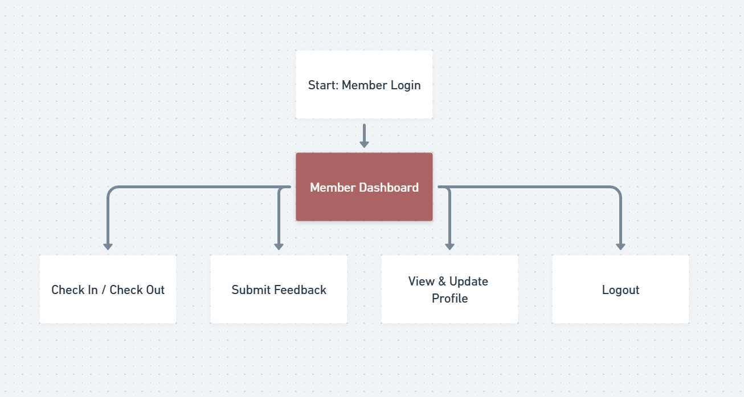

Slide 9

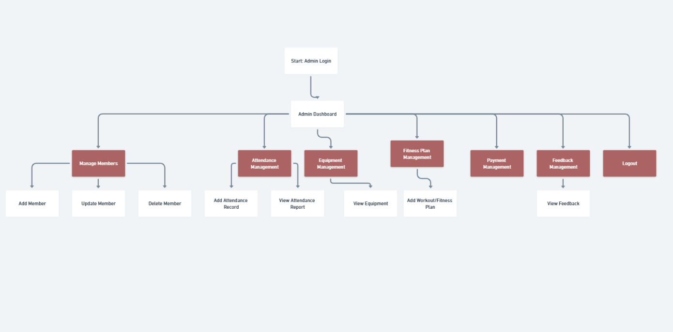

Slide 10
Project/
|--config/
|--__init__.py
|--config.py
|--models/
|--equipments.py
|--feedback.py
|--member.py
|--payment.py
|--workout.py
|--static/
|--images/
|--javascript.js
|--style.css
|--templates/​
|--admin.html​
|--admin_dashboard.html​
|--admin_login.html​
|--attendance_report.html​
|--index.html​
|--login.html​
|--member.html​
|--member_dashboard.html​
|--member_feedback.html​
|--member_login.html​
|--member_payment_history.html​
|--payment_history.html​
|--signup.html​
|--update_member.html​
|--user_profile.html​
|--view_equipments.html​
|--view_feedback.html​
|--view_members.html​
|--add_equipments.html
|--add_member.html
|--add_payment.html
|--app.py​
|--.env.txt

Slide 11
Data Structures Used :

Slide 12
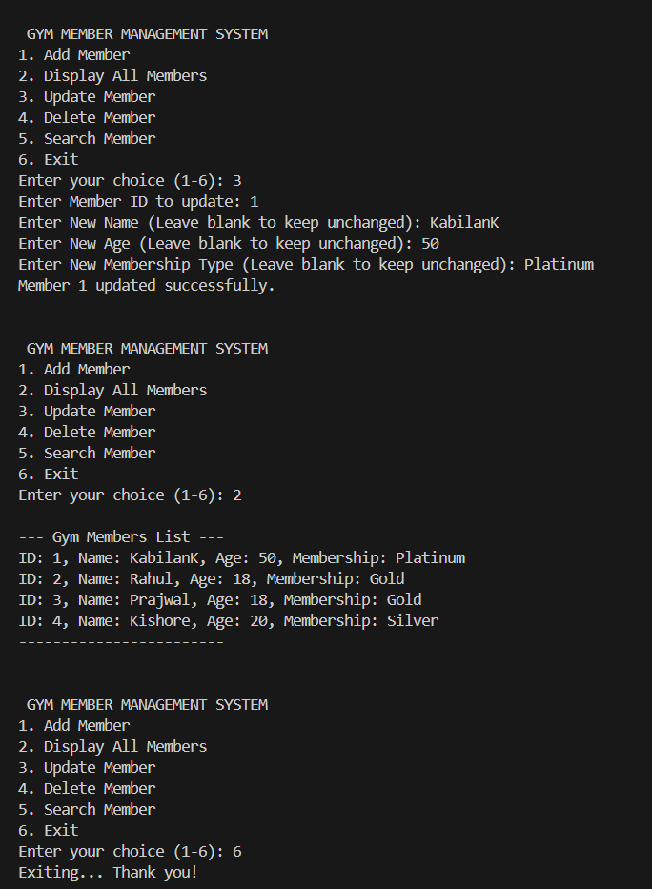
Results Obtained in Review 1:

Slide 13
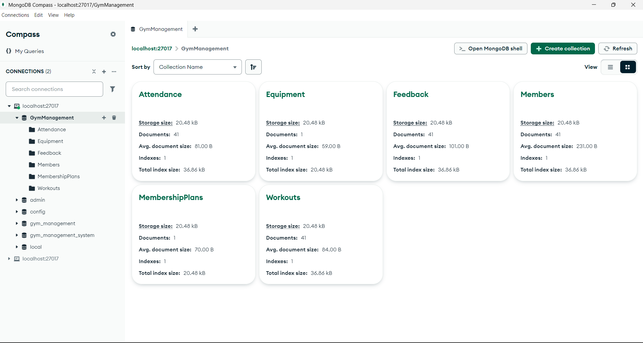

Slide 14
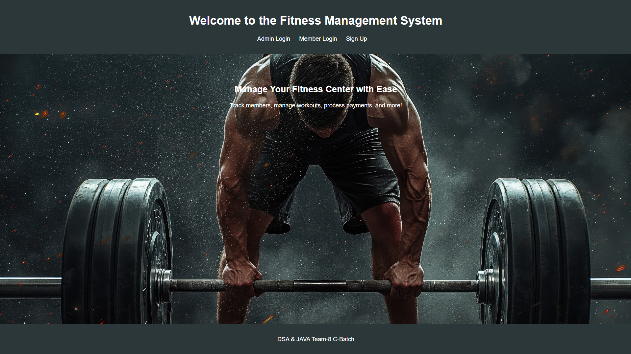
Results obtained till now.

Slide 15
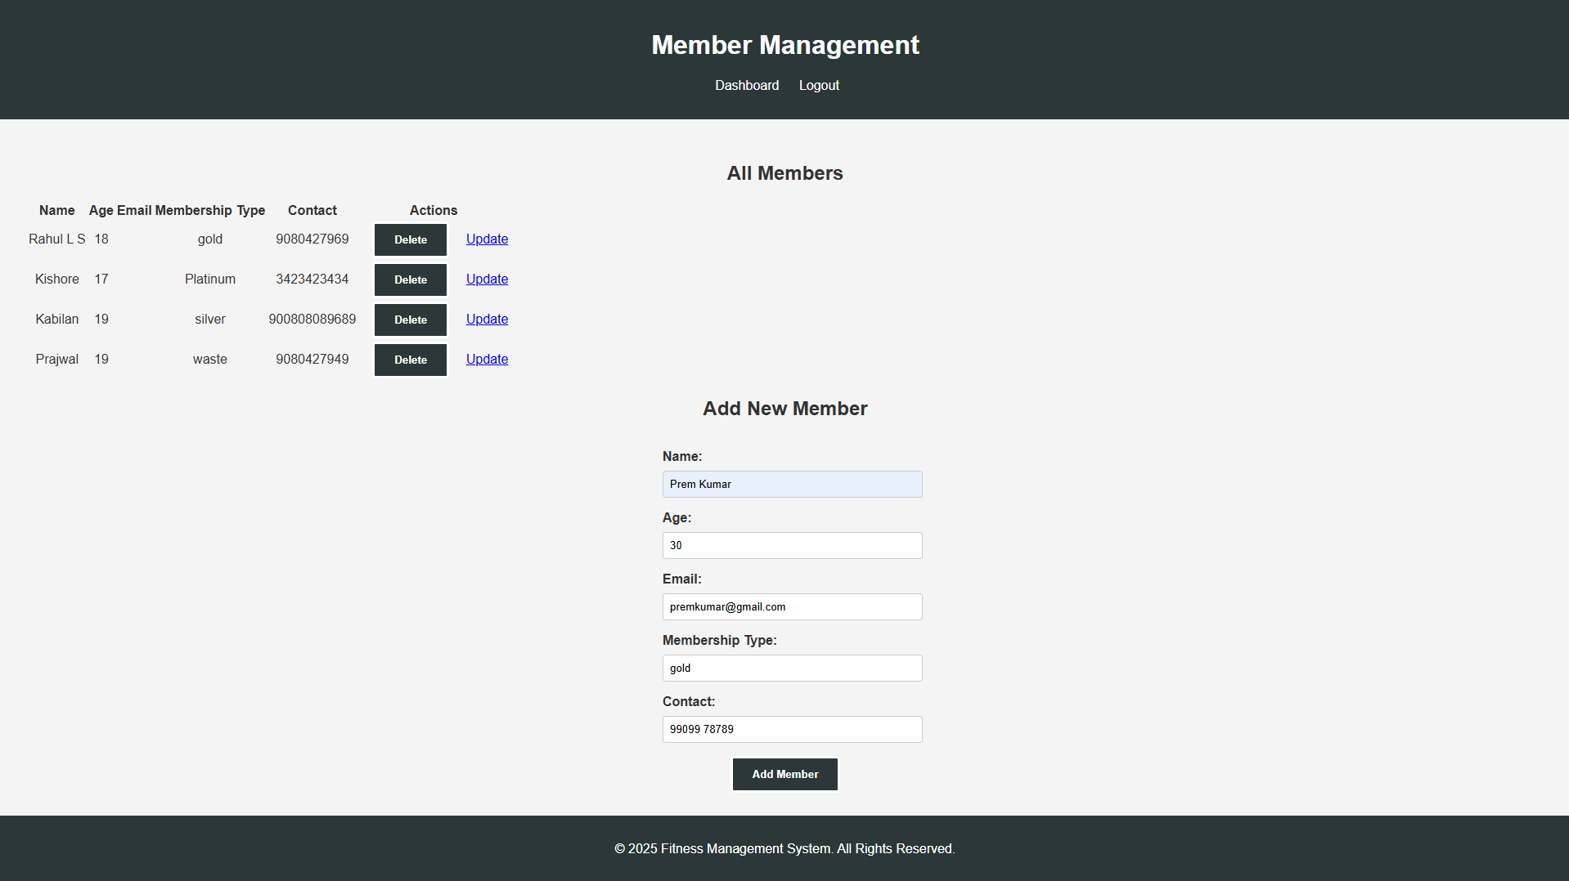
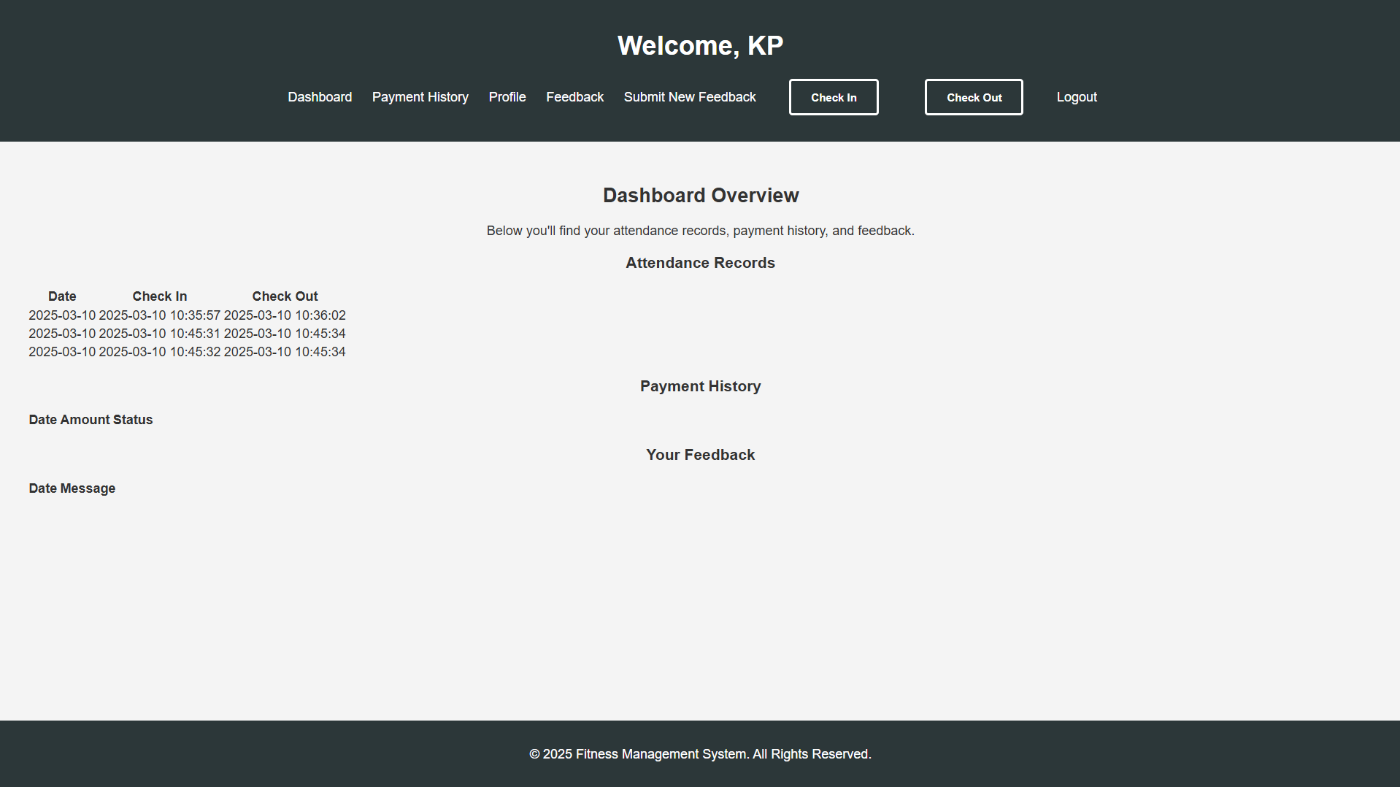

Slide 16
Tools Used :
Project Overview : Your project is a full-stack web application for managing a fitness center.
It is built with:
Backend: Python (Flask)
Database: MongoDB (accessed via Flask-PyMongo)
Frontend: HTML, CSS, and JavaScript

Slide 17
Future Work
Gamification --> Display the stats of members. Giving rewards for streak maintaining members.
Equipements list
Guest Pass Management
Capacity Mangement based on timing
Emergency Contact
Nutritionist Plan using API
Hashing the passwords and storing in the database
Regex Search in Mongo DB

Slide 18
Thank you
Team – 8 , C - Batch

